Slide 1
Scholar Plot – Data Visualization for Scientific Careers
Kyeongan (Karl) Kwon
PhD Proposal
Advisor: Prof. Ioannis Pavlidis
Friday February 26, 2016 11:00 AM
Notes:
Hello everyone, Thank you for coming for my presentation today.
My name is Kyeongan Kwon. However, I go by Karl.
I am a 5th year PhD student in computer science at UH. I am also a member of CPL and working with Prof. Pavlidis.
Today, I am going to present my PhD proposal about data visualization for scientific careers.

Slide 2
Overview
Introduction
Design Philosophy and Methodology
Demo – www.ScholarPlot.com
Architecture
Conclusion and Future Work
Acknowledgment
Notes:
This is overview about the presentation.
In introduction, I am going to talk about the research problem and related work.

Slide 3
What is Data Visualization?
Data visualization is the presentation of data in a pictorial or graphical format
Facilitate intuition
Support qualitative analysis
Notes:
Before start to present my research,
I would like to talk about a little bit what data visualization is exactly.

Slide 4
Why Data Visualization Matters?
Visualization facilitates data access
Visualization brings up patterns and pattern violations
Visualization supports actionable insights
Visualization aids in the comprehension of big data
Notes:
Because of the way the human brain processes information,
using charts or graphs to visualize large amounts of complex data is easier than poring over spreadsheets or reports.
Data visualization is a quick, easy way to convey concepts in a universal manner – and you can experiment with different scenarios by making slight adjustments.
(trends, gaps, outliers)

Slide 5
Introduction
Appraising academic careers
Hiring faculty
Promotion and Tenure
Peer-reviewing
Matching students to advisors
Notes:
A Good Research Problem
There are difficult and time consuming tasks
when Appraising academic careers.
For examples,

Slide 6
Introduction
Curriculum vitae (CV)
Lengthy
Often convoluted
With potential errors / misses
Inconsistent content & form
Difficult and time consuming to analyze academic CVs
Methods that can help
Data Science / Data Analytics / Data Visualization
… 30, 40, 50 ... pages
Notes:
CV (where your publishing and research history as well as your memberships and fellowships) is still very popular to evaluate
Why it is inconsistent. For example, event the way people list their publications is inconsistent.
Journal (IF or not) , Conference (Acceptant rate or not )

Slide 7
Goals of Research
GOAL 1: Articulate a clear, comprehensive, and measurable performance evaluation scheme for academics
The scheme should reveal causal relationships among merit criteria
The scheme should be scale invariant
GOAL 2: Design a visualization to bring the said performance evaluation scheme to life
GOAL 3: Implement and test the said visualization, drawing from actual public data

Slide 8

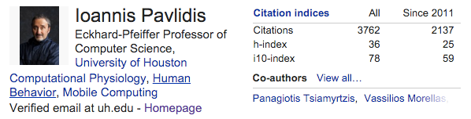
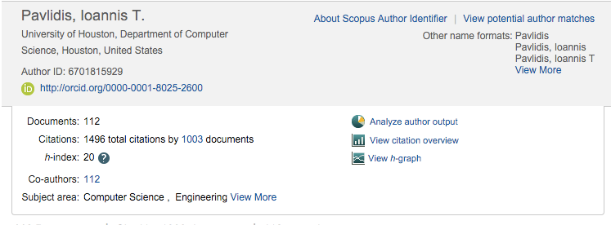

Related Work - Software
Missing about 2,000 citations, 16 h-index
Google Scholar
+ Free; inclusive
- Publications only; little visualization
Scopus
- Subscription based
- Not as inclusive as Google Scholar
ORCID
+ Publications; funding
- Requires extensive set-up
Notes:
Google Scholar
Free, All inclusive
Only publications
Scopus
Login Required to Access Scopus in your institution's network
Only publications
ORCID
Individuals need to set up

Slide 9
Related Work - Literature
Article | Author | Year | Conclusion
“Visualization of the citation impact environments of scientific journals” Journal of the American Society for Information Science and Technology | L Leydesdorff | 2007 | Effort focused on visualizing citation patterns using a journal data set
“Augmenting the exploration of digital libraries with web-based visualizations” IEEE Fourth International Conference on Digital Information Management (ICDIM 2009) | P Bergstrom D Atkinson | 2009 | Exploring patterns in the literature using a static data set at CiteSeer
“SciVal experts: A collaborative tool” Medical Reference Services Quarterly | E Vardell T Feddern-Bekcan M Moore | 2011 | Summary of researchers’ profiles using Scopus
“Scholarometer: A system for crowdsourcing scholarly impact metrics” Proceedings of the 2014 ACM Conference on Web Science (WebSci 2014) | J Kaur M JafariAsbagh F Radicchi F Menczer | 2014 | Citation analysis using Google Scholar, but no Impact Factor and no funding information
Notes:
Google Scholar
Free, All inclusive
Only publications
Scopus
Login Required to Access Scopus in your institution's network
Only publications
ORCID
Individuals need to set up

Slide 10
What Is Missing?
Unambiguous scheme for academic performance
Summary interface to facilitate executive decisions
Scholar Plot fills the gap
Well-thought scheme for academic performance
Visual summary
Notes:
There is no definitive scheme for evaluating academics.
Everybody has own ideas.
Big journal is good, many cited publication is also good.
This isn’t clear, how it is related to each other.

Slide 11
Design Philosophy
Merit criteria for evaluation of academic performance
Impact
post-production merit
Prestige
pre-production merit
Funding
enabler of production
Visualization
Impact linked to vertical axis - visibility
Prestige linked to disk size - fancy factor
Funding placed at the bottom - causality
2
1
3
Notes:
Let me tell you how I structured this visual abstract based on three design principles.
I will consider product parts.
Pre – time distinguished published. How famous’ places where you published.
Post – what happened after you published.
How do I represent to pre-production merit
impact of the intellectual products
prestige of the venues where intellectual products appear
funding that enables intellectual production
Why impact on the vertical scale is not a Impact Factor but citation because of the fixed scale of Impact Factor (1-60), citations could reach 100,000

Slide 12
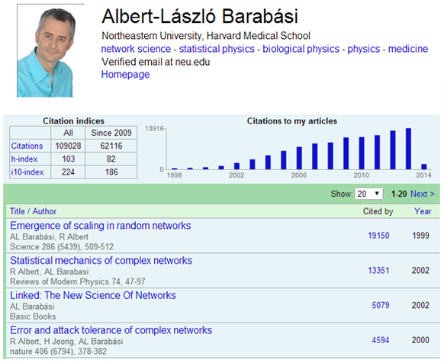
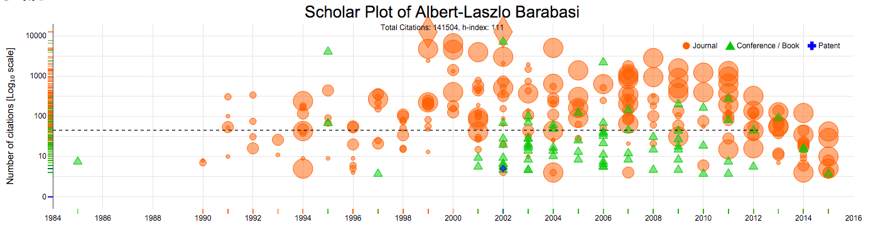
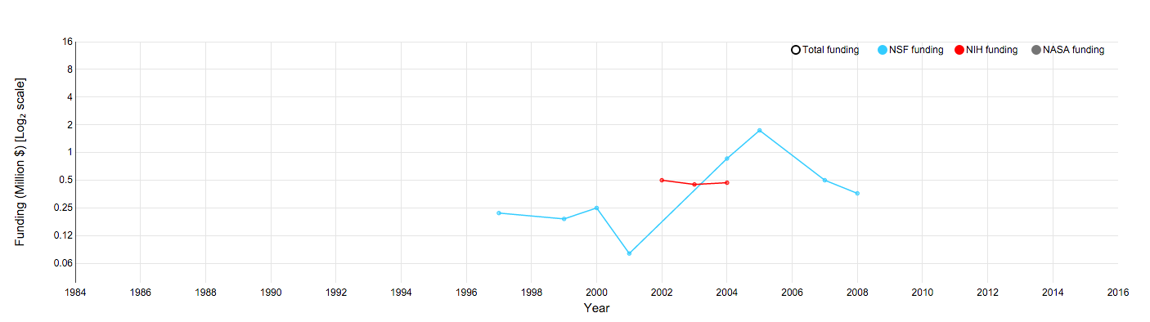
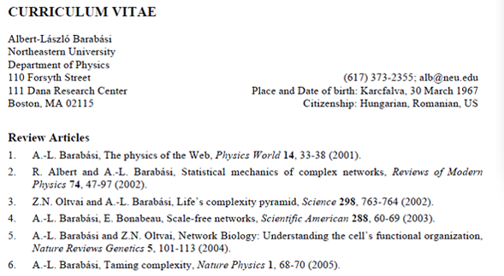
Design Methods
A. Google Scholar Profile
C. Scholar Plot
B. Curriculum Vitae
Notes:
I have three figures of the same scholar in order to see the difference.
Google Scholar Profile. Only bar chart ; publication list
Curriculum Vitae, a brief account of a person's education, qualifications, and previous experience. It is still very popular. However, user needs to make themselves as PDF and always need to update it whenever new publications appeared.
Here, I want to ask you what these are missing?
- One when is the first and least publication they are published.
– Another is you have no idea that

Slide 13
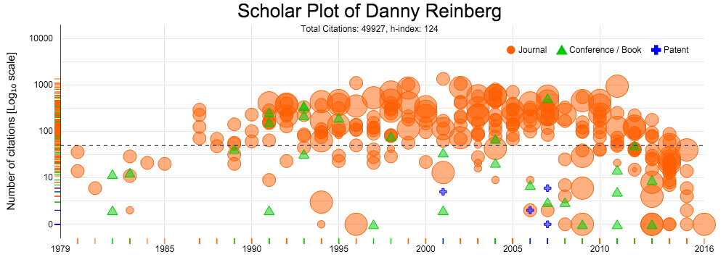
Design Methods
Visualization of Publication Record
Notes:
Professor of Biochemistry, NYU School of Medicine
https://scholar.google.com/citations?user=nFuH4MMAAAAJ&hl=en&oe=ASCII
This is one result of a scholar who have about 300 publications includes all Journal/ Conference and Patents.
It is easy to identify what type of publication powers the individual’s scholarship - a correlate of disciplinary culture.

Slide 14
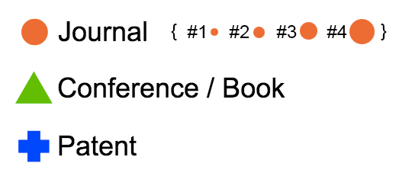
Design Methods – Prestige
Publication symbols
Journal (A ~ r²)
Conference / Book
Patent
Disk sizes for prestige visualization
IF bracket ( IF < 2) - #1
IF bracket (2 ≤ IF < 4) - #2
IF bracket (4 ≤ IF < 16) - #3
IF bracket (IF ≥ 16) - #4
 | IFs | Journals
#1 | <= 2 | 5554
#2 | 2 - 4 | 1948
#3 | 4 - 16 | 808
#4 | 16 >= | 62
Journals
* IF - Impact Factor
IF
Notes:
Differentiate different prestige
Journal has little different prestige because it has only a widely accepted ranking system that is the Journal Impact Factor (IF) List.
Conference has acceptance rates and some general guide line to tell the rank of conferences like A+ / A. However, some has no these information.
Patents have no this type of information.
Disk size
How do I present this value from lower to higher IF.
I did some data analytics for this.
Frequency of Journal published by Thomson Reuters
Four categories based on histogram analysis. I use this to commensurate the size of disk.
- We chose disks to be the symbols of journal publications, as disk scaling can be done very effectively by simply varying its radius (A ∼ r2).
Specifically, after performing histogram analysis on the IFs of journal publications, we settled on four disk sizes to represent journal prestige: #1 < #2 < #3 < #4 (Fig. 2). We found that the great majority of journal publications appear in journals with IF < 2, assigning to this cohort the smallest disk size symbol, #1. These are mid- level specialized technical and scientific journals.
The next IF bracket (2 ≤ IF < 4) includes high quality specialized technical (e.g., IEEE Transactions) and scientific journals represented by disk #2.
The third IF bracket (4 ≤ IF < 16) includes very high quality science journals and specialized medical journals represented by disk #3.
The top IF bracket (IF ≥ 16) includes famous general science journals (e.g., Nature) and top medical journals (e.g., New England Jour- nal of Medicine); they are assigned the largest disk, #4.

Slide 15
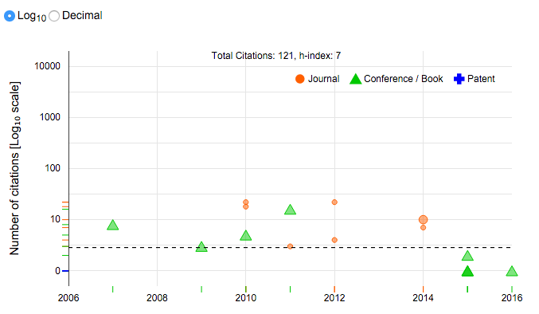
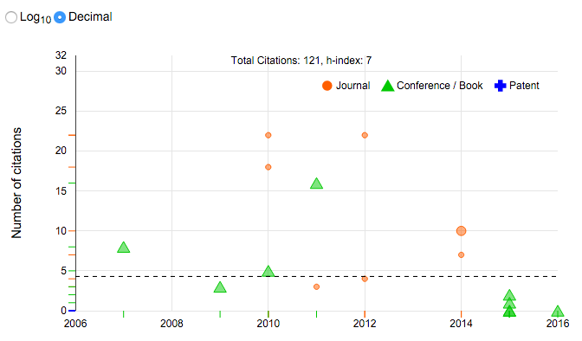
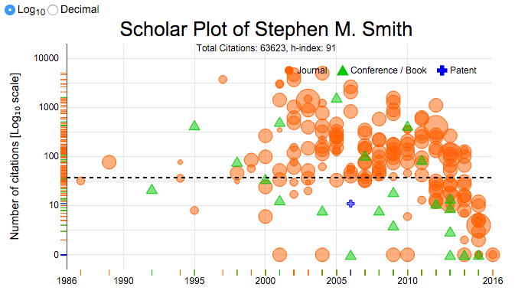
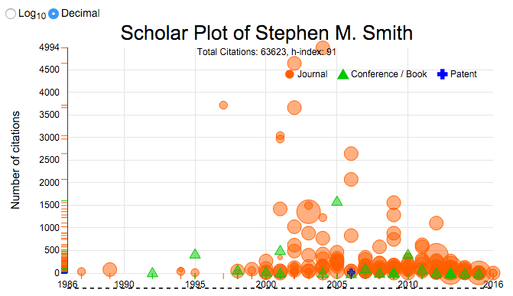
Design Methods – Impact Scales
Log and Decimal scales
Senior records vs. junior records
Log₁₀ (Default)
Decimal
Notes:
Individual SP publication plot has two different scales views to create a standardized scale for the y-axis for comparison, we introduced a log10 scale for the default plot and an option to toggle to the decimal scale view.
If you have a senior records, and put it as a decimal scale, it suppress visualization.
However, junior records isn’t important because you hardly can see the difference.
That’s why Logarithm is default. It makes the difference visibility.
Senior record - https://scholar.google.com/citations?user=gRptb5UAAAAJ&hl=en&oe=ASCII (Oxford)
Junior record - Alexander V Mamonov -https://scholar.google.com/citations?user=GJkXDKsAAAAJ&hl=en&oe=ASCII (U of H)

Slide 16
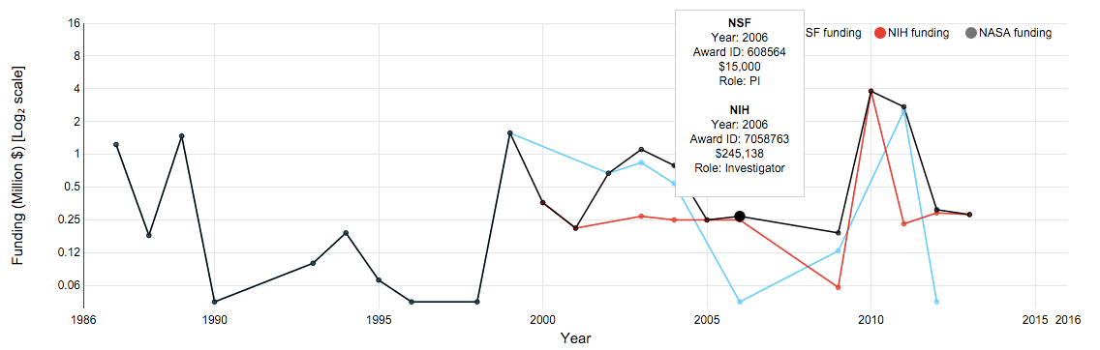
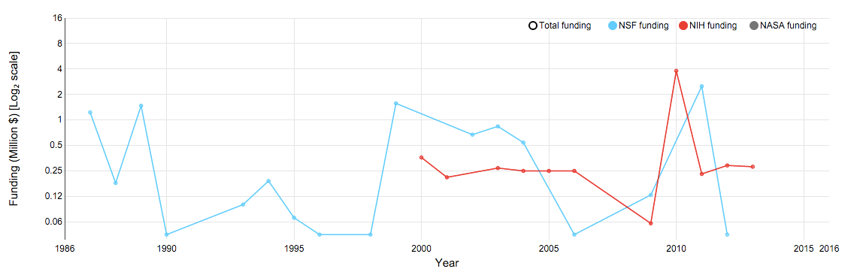
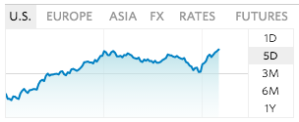
Design Methods - Funding
Tooltip displays details
Agents, Year, Award ID, Amount and Roles such as PI, Co-PI, Investigator
Notes:
Scholar Plot also depicts the NSF/NIH/NASA funding of an individual as a multiline in log₂ scale
Line Chart is proper for me to use visualizing funding data because it is commonly used like stock markets.

Slide 17
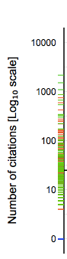
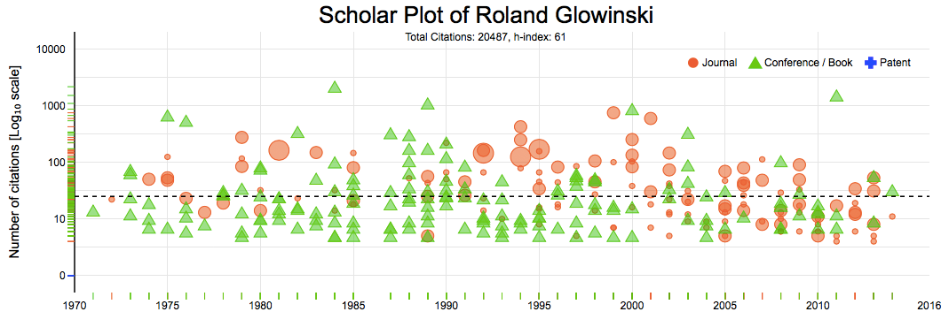
Design Methods – Ranked Density of Publication Types
Examples of different scholarly profiles
Mix of journal and conference papers
A

Slide 18
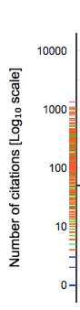
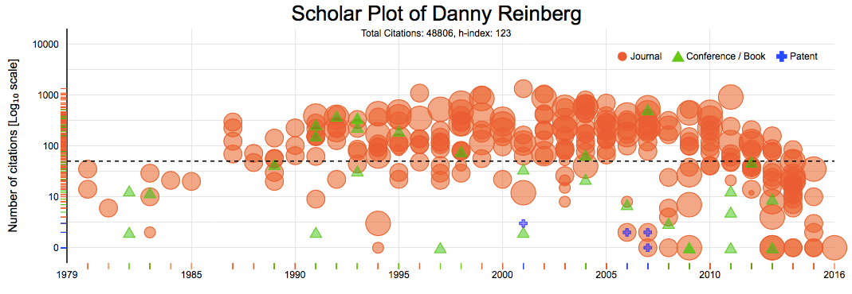
Design Methods – Ranked Density of Publication Types
Examples of different scholarly profiles
Mix of journal and conference papers
Preponderance of journal papers
B

Slide 19
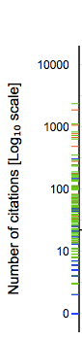
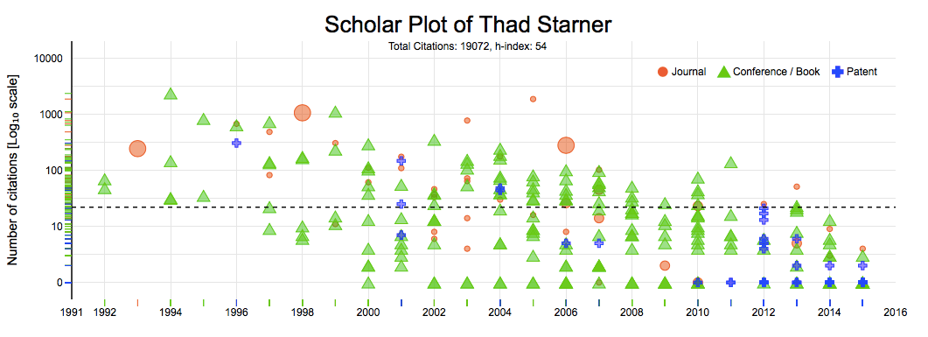
Design Methods – Ranked Density of Publication Types
Examples of different scholarly profiles
Mix of journal and conference papers
Preponderance of journal papers
Mix of conference papers and patents
Why this is useful?
Aids in comprehending the scholarly profile
Reveals the type of publication producing the biggest impact
A
B
C

Slide 20
Prototype!
Notes:
Now I had a prototype.
I gave the evaluation to focus group and user study.

Slide 21
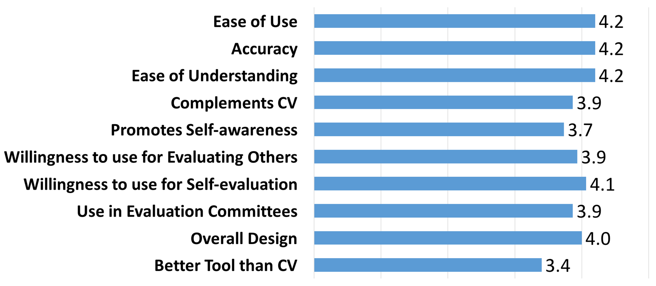
Evaluation - User Study
Participants (n=15) included graduate students, postdocs, and faculty from natural, mathematical and social sciences
Likert scale from 1 to 5, with 1 being strongly disagree and 5 begin strongly agree
Conclusion: Scholar Plot is a friendly tool that academic users find of interest and value
Notes:
I have two evaluations
User study
A total of n = 15 participants from various natural, mathematical, and social sciences participated in the user study, which was approved by the Institutional Review Board (IRB) of the University of Houston.
We asked each participant to review and interact with the SP interface before completing an online survey.
The participants answered 10 questions on a Likert scale from 1 to 5, with 1 being strongly disagree and 5 being strongly agree.
Usability, accuracy and intuitive understanding of SP scored the highest (μ = 4.2).
Another key result is that the participants were planning to use SP frequently (μ = 4.1).
Overall, the survey confirmed that the base level of SP is a user- friendly tool that academic users find of interest and value.

Slide 22
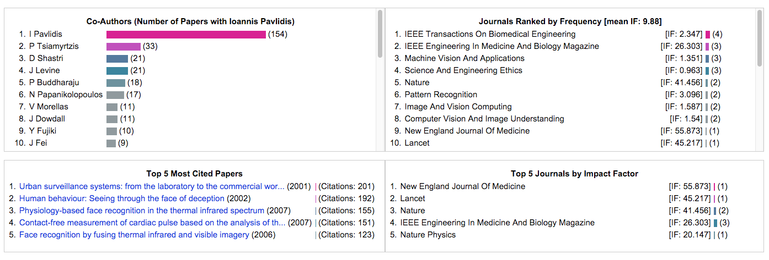
Evaluation - Focus group
Focus group (n=12) at Northwestern University
Resulting improvements: Four ancillary panels
Team science profile
Prestige + impact details
Team
Prestige
Impact
Notes:
Initial feedback through a focus group, we’ve added 4 panels below scholar plot results.
Team science information.
- the number and intensity of collaborations for the depicted scholar.
Summarize highly cited papers.
- the scholar’s most popular papers.
Interface journal profile
- the specific journals where the scholar publishes most often and their impact factors.

Slide 23
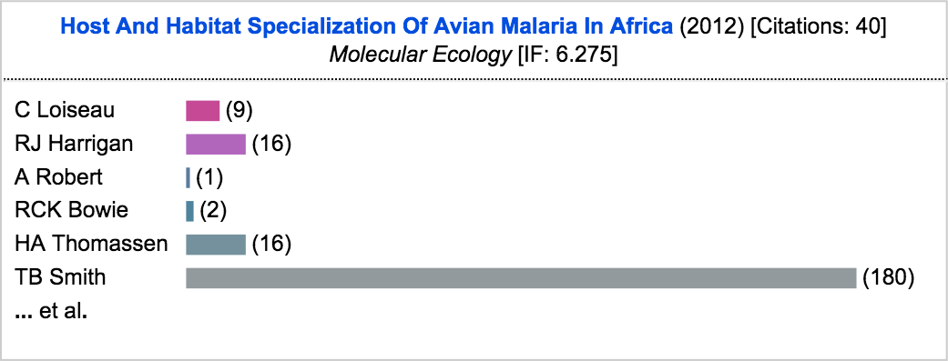
Design Methods – Details on Demand
Tooltip for details
Title, Year of Publication, Citation number, Journal [Conference, Patent] name and Impact Factor value
Co-Author list with bars representing the strength of collaboration history
Notes:
We have another feature that interact an each plot.
When you interact with a plot, it shows the tooltip, which includes paper title, year of publication, the number of citations, journal or conference name and journal impact factor.
this is optional

Slide 24
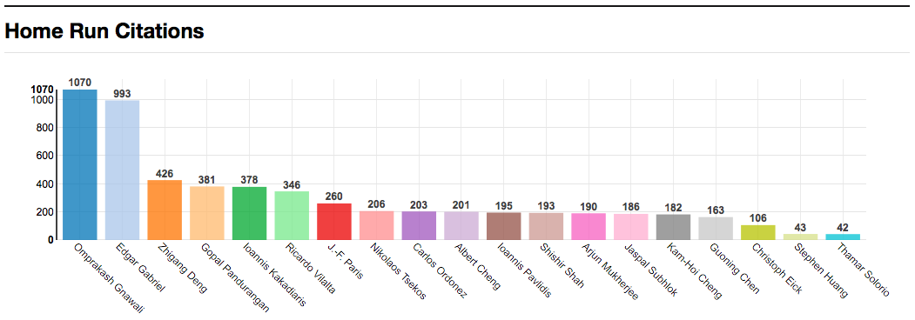
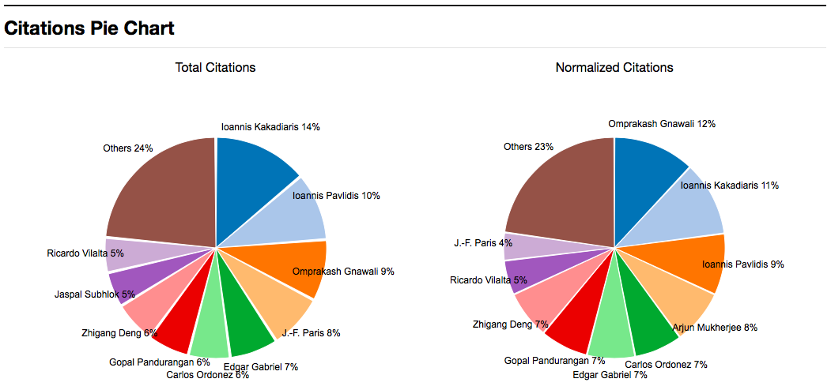
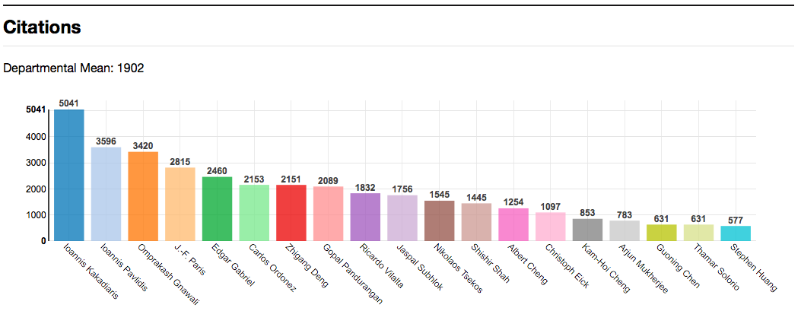
Design Methods – Department Plot
Computer Science, University of Houston
Impact: post-production merit
Notes:
We have another feature that interact an each plot.
When you interact with a plot, it shows the tooltip, which includes paper title, year of publication, the number of citations, journal or conference name and journal impact factor.
Group level - bring three merit.

Slide 25
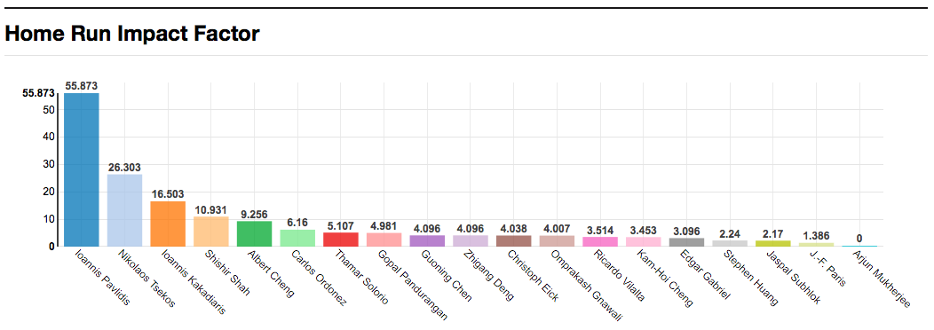
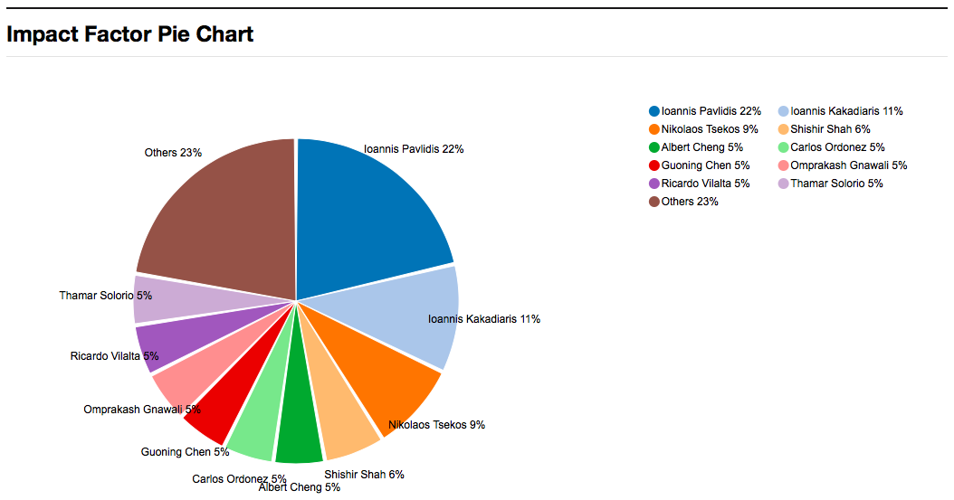
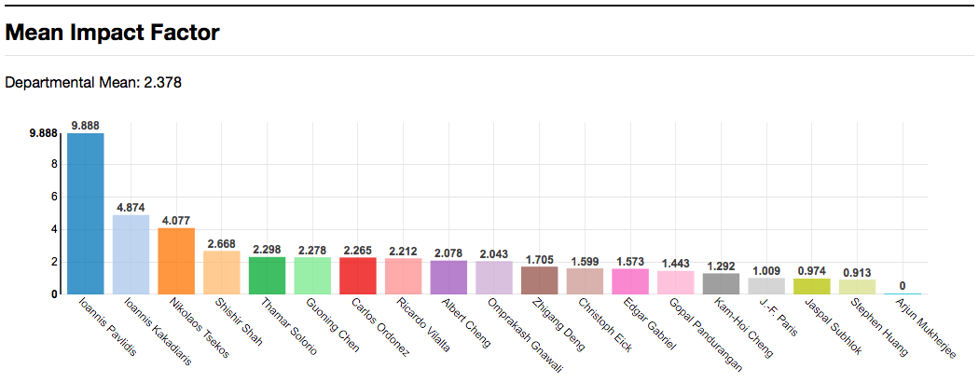
Design Methods – Department Plot
Computer Science, University of Houston
Prestige: pre-production merit
Notes:
We have another feature that interact an each plot.
When you interact with a plot, it shows the tooltip, which includes paper title, year of publication, the number of citations, journal or conference name and journal impact factor.
Group level - bring three merit.

Slide 26
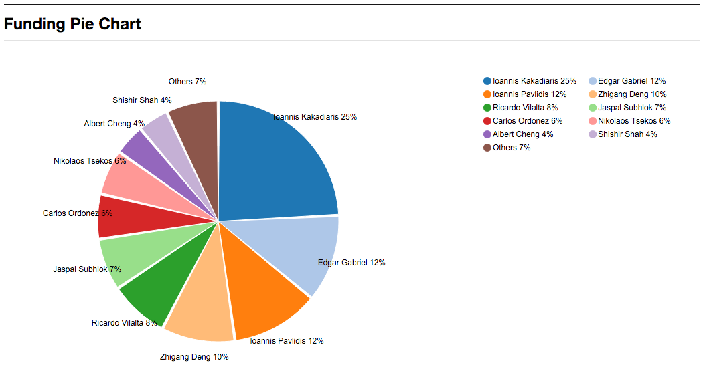
Design Methods – Department Plot
Computer Science, University of Houston
Funding: Enabler of production
Notes:
We have another feature that interact an each plot.
When you interact with a plot, it shows the tooltip, which includes paper title, year of publication, the number of citations, journal or conference name and journal impact factor.
Group level - bring three merit.

Slide 27
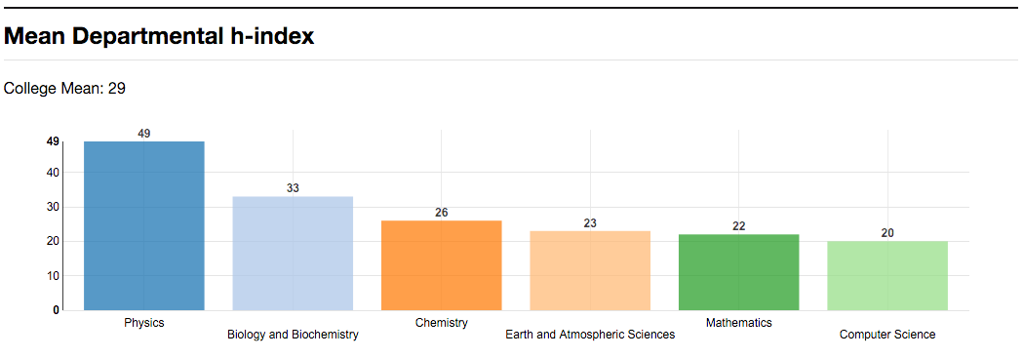
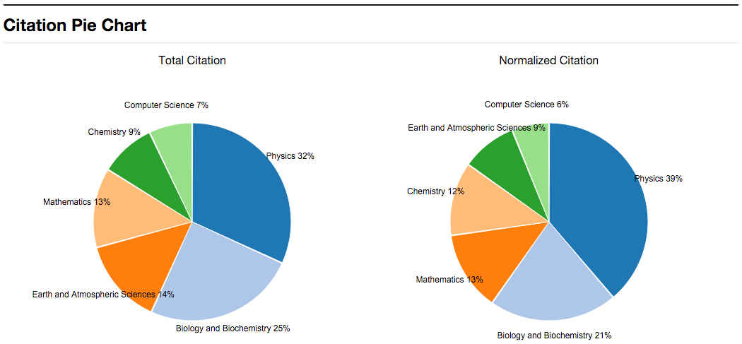
Design Methods – College Plot
Natural Sciences and Mathematics, University of Houston
h-index, Citations, Impact Factor
Notes:
We have another feature that interact an each plot.
When you interact with a plot, it shows the tooltip, which includes paper title, year of publication, the number of citations, journal or conference name and journal impact factor.
this is optional

Slide 28
Demo
Scholar Plot
Notes:
Now, I want to talk about the engineering part.

Slide 29
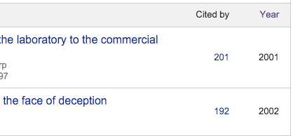

Data Sources
Impact – Citations from Google Scholar
Prestige – Impact Factor from Thomson Reuters
Funding – NSF/NIH/NASA from Government
NSF: FY 1985 - FY 2013 (29 years, 312,311 rows, 10,769/year)
NIH: FY 2000 - FY 2013 (14 years, 777,657 rows, 55,456/year)
NASA: FY 2007 - FY 2015 (9 years, 16,670 rows, 1,852/year)
Notes:
Where do I get this data regarding three schemes.
How all these things work together in a real system.
Let me show a diagram.

Slide 30
Architecture
Dynamic data – On Demand
Authors
Impact Factor
NSF, NIH, NASA
Yearly Update
Notes:
Where do I get this data regarding three schemes.
How all these things work together in a real system.
Let me show a diagram.

Slide 31
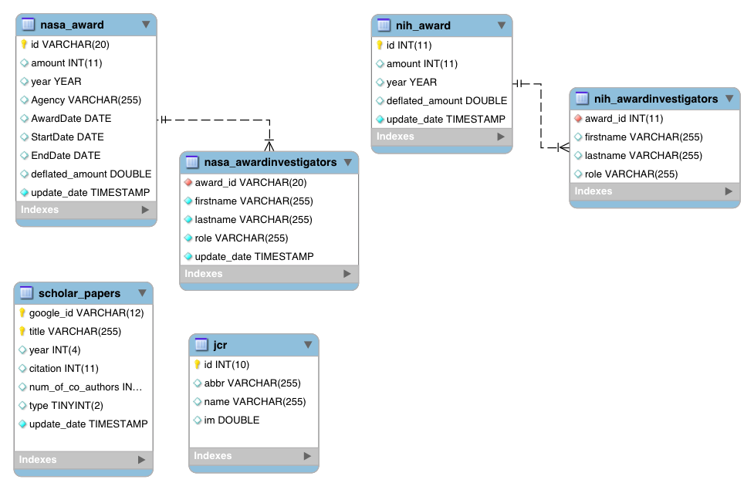
ER Diagram
Notes:
Where do I get this data regarding three schemes.
How all these things work together in a real system.
Let me show a diagram.

Slide 32
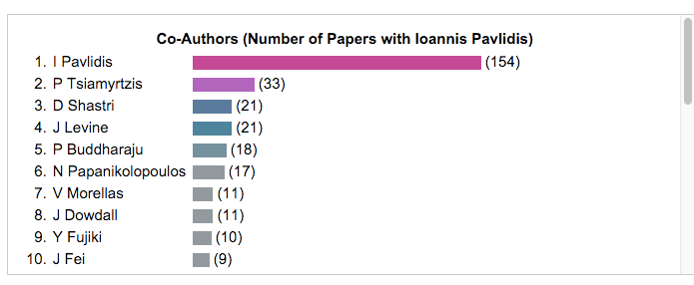
Name Disambiguation
1. Google Scholar includes many different cases on its page of papers
Ioannis T Pavlidis
IT Pavlidis
I Pavlidis
Ioannis Pavlidis
I Pavlidis
First Initial + Lastname
Notes:
The most important of which is name disambiguation for authors and co-authors in the Google Scholar data.
Each Google Scholar - to figure out co-author
biggest problem is middle name
exampe for

Slide 33
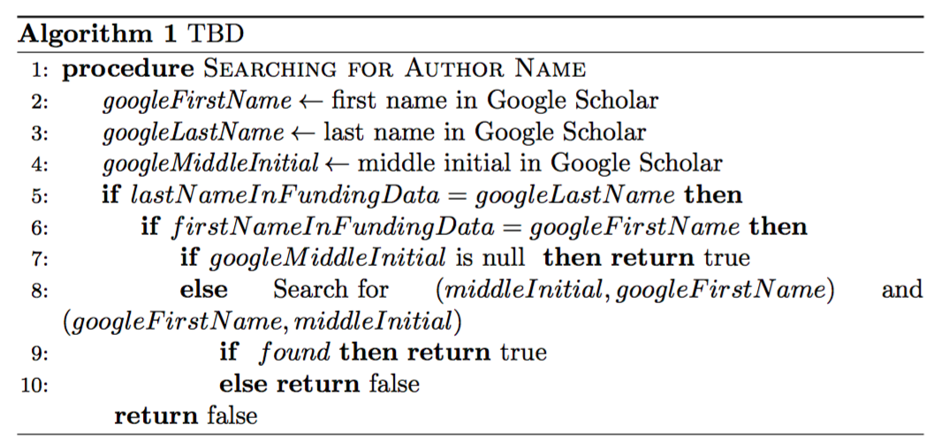
Name Disambiguation
2. Matching Google Scholar name with Funding name
Funding dataset
Remove Jr. III, PhD, Dr., and so on
Google Profile
Funding
Daniel M. Smith
Daniel Michael Smith
M % Daniel
Daniel Michael
Daniel M %
Daniel Michael
Notes:
Matching
Title will be placed
1. remove
2. matching

Slide 34
Conclusion
GOAL 1: Articulate a clear, comprehensive, and measurable performance evaluation scheme for academics
1.1 : The scheme should reveal causal relationships among merit criteria
Funding + pre-production credit + post-production credit
1.2: The scheme should be scale invariant
Individual or Department or College (composite personhood)
Notes:
We presented Scholar Plot (SP), a compact and scalable (individual-department-college) visualization interface for academic merit. We released SP at http://scholarplot.com.
The basic idea behind SP is to facilitate instant deeper insights regarding different strengths of academic records, supporting the work of evaluation committees and the curious academic in search of an advisor or department. One of SP’s strengths is that it draws data from open sources that are inclusive.

Slide 35
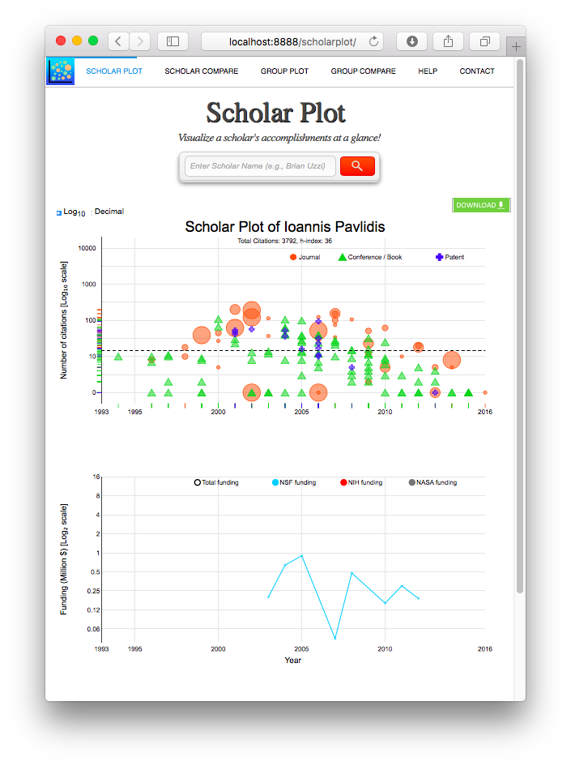
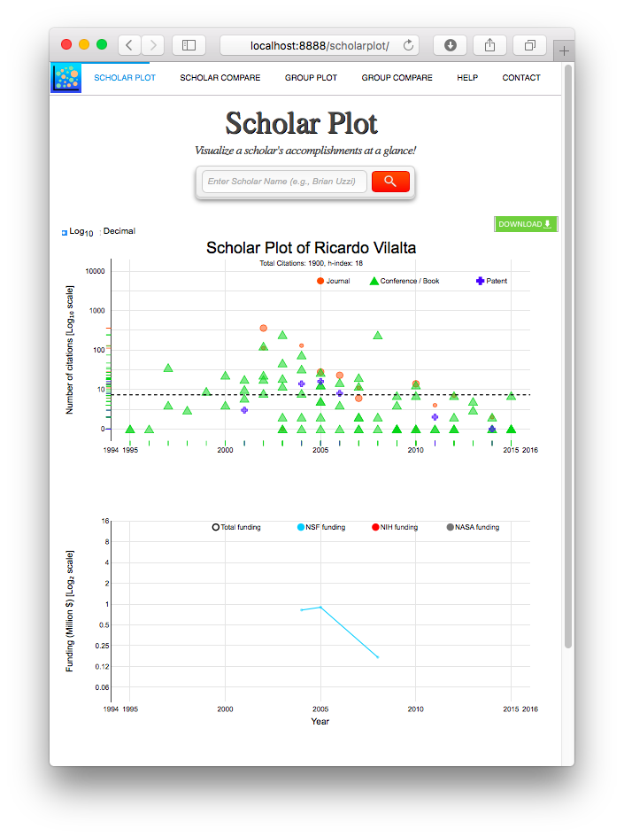
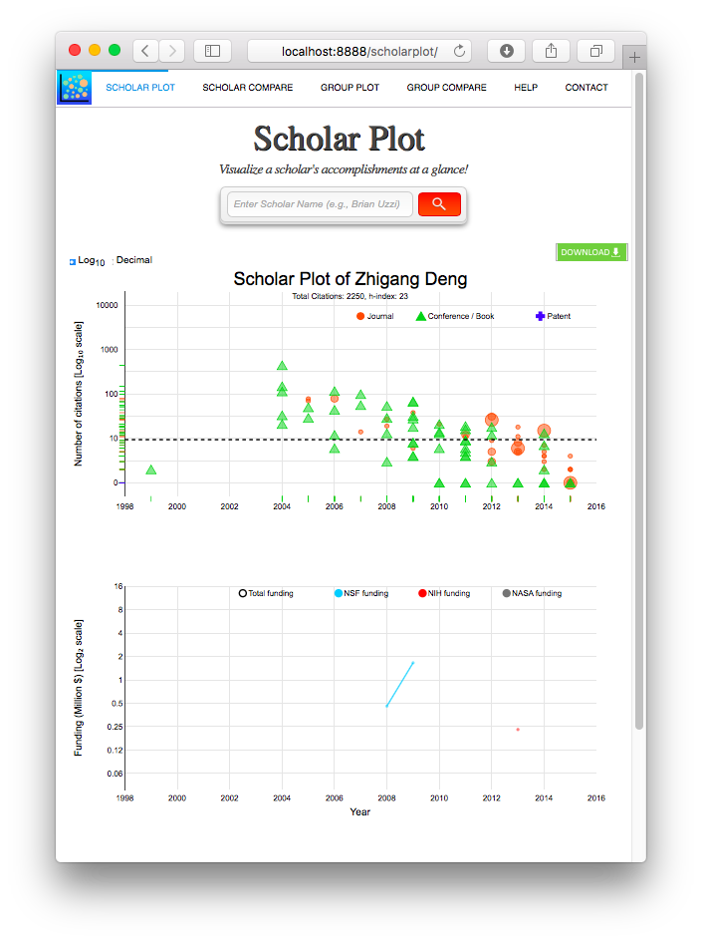
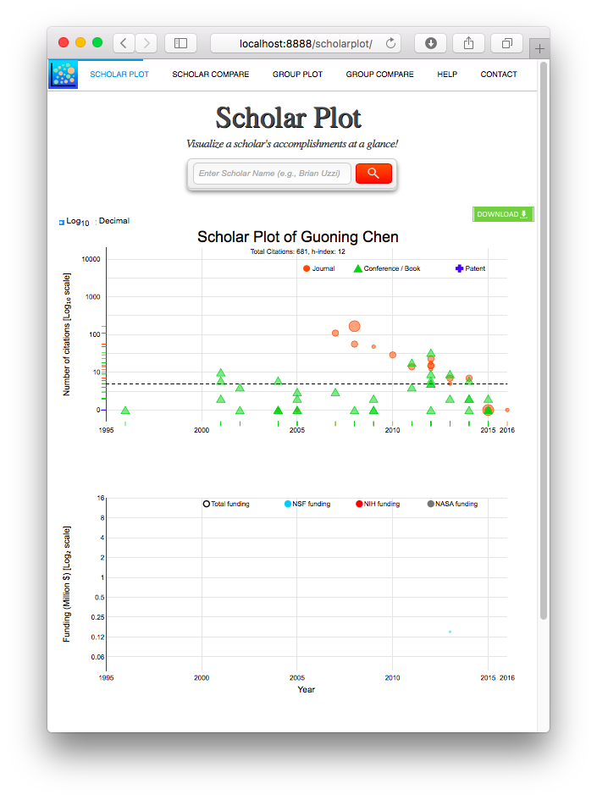
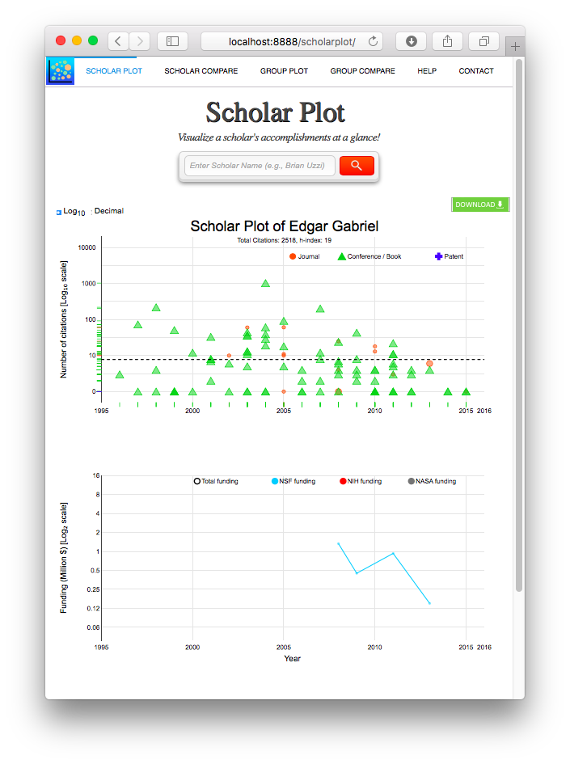
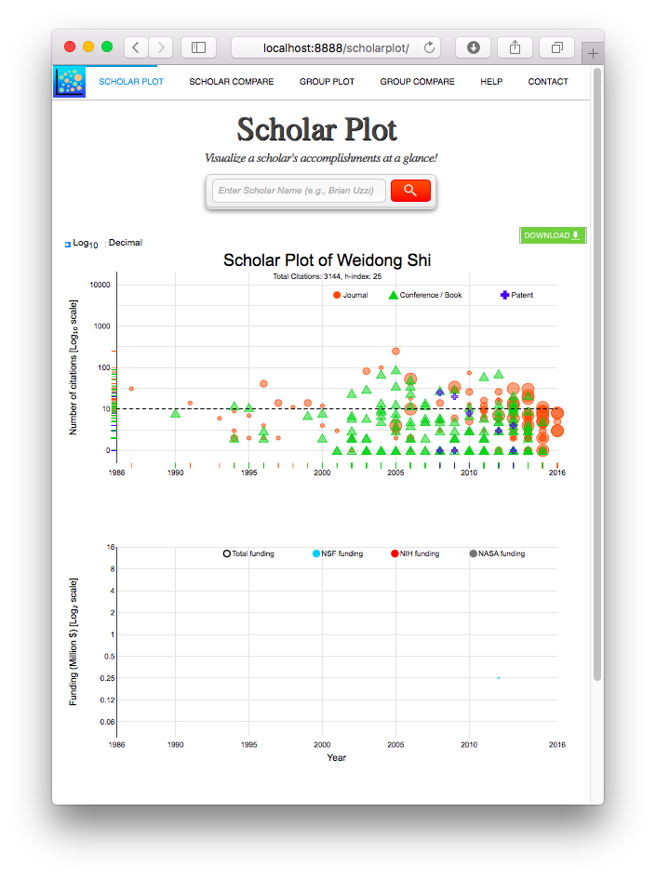
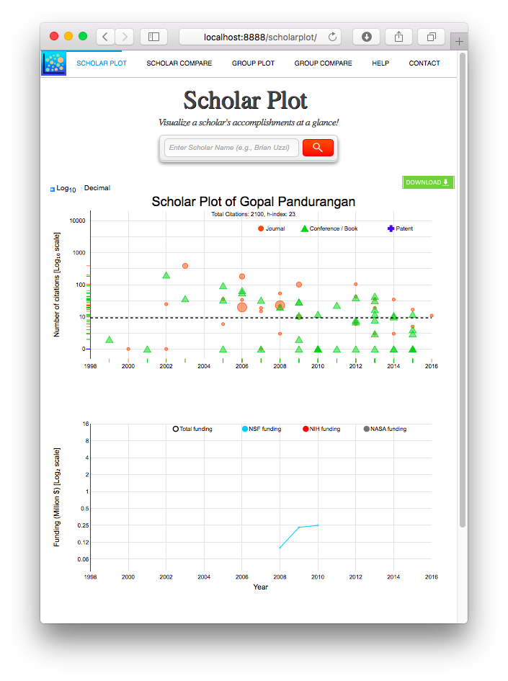
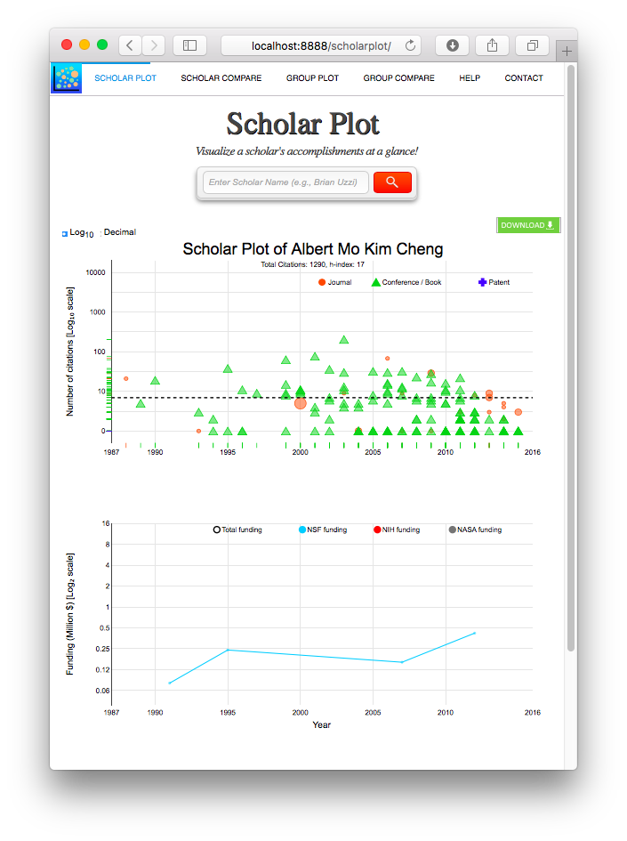
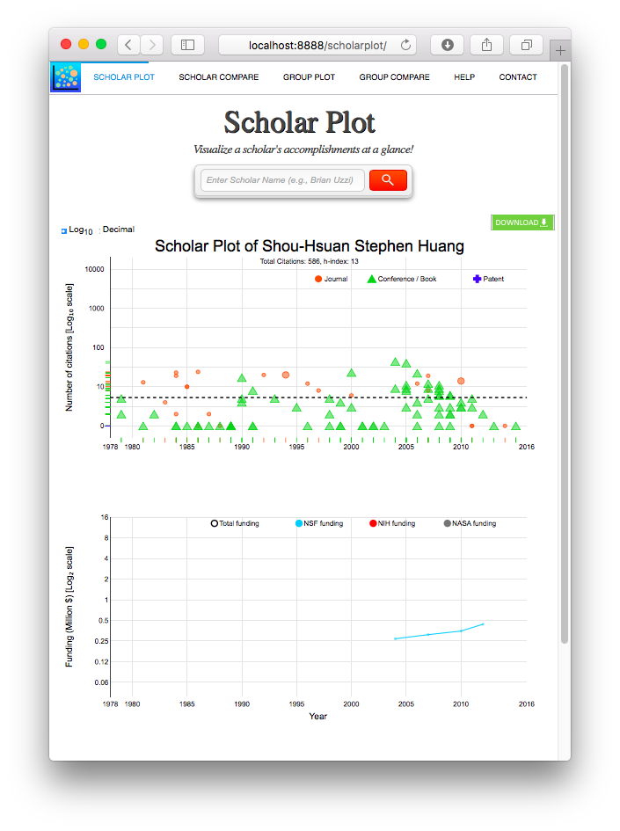
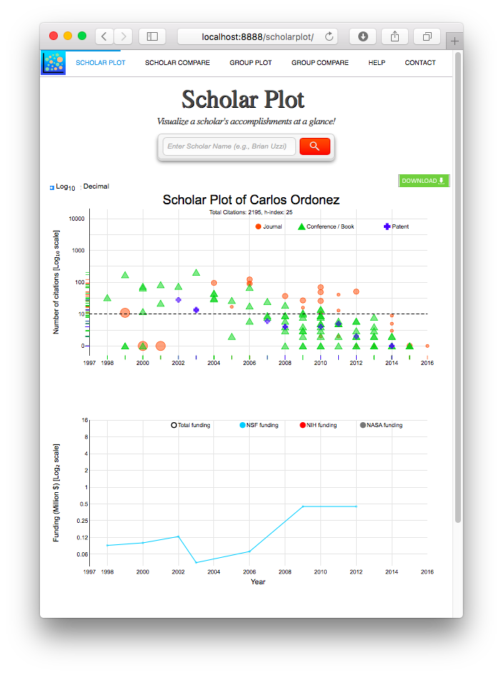
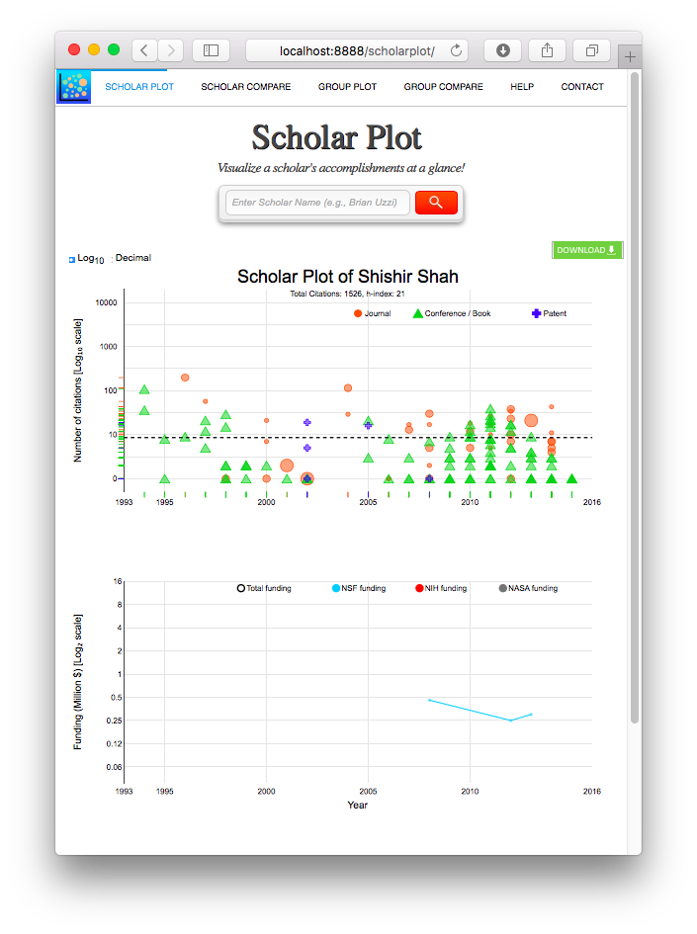
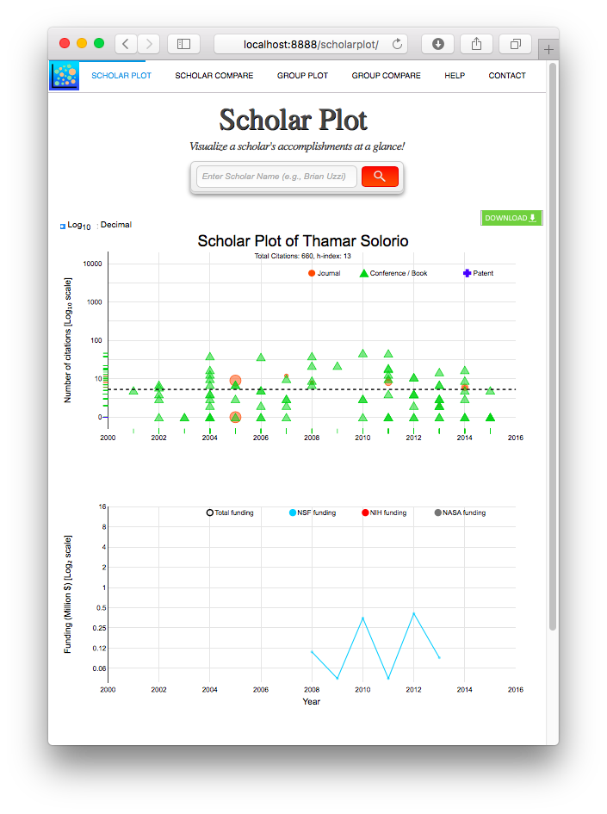
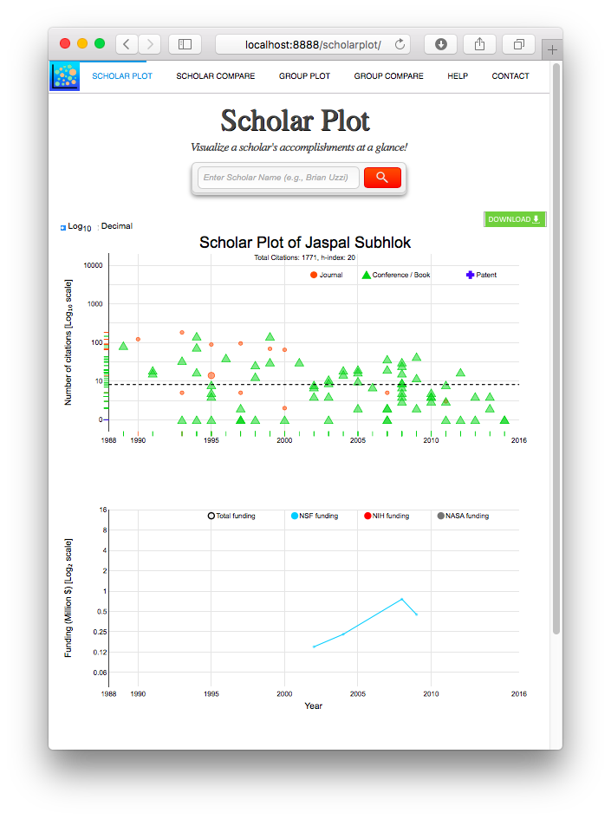



Conclusion
GOAL 2: Design a visualization to bring the said performance evaluation scheme to life
Scholar Plot is good for individuals
Not scalable to groups
Notes:
We presented Scholar Plot (SP), a compact and scalable (individual-department-college) visualization interface for academic merit. We released SP at http://scholarplot.com.
The basic idea behind SP is to facilitate instant deeper insights regarding different strengths of academic records, supporting the work of evaluation committees and the curious academic in search of an advisor or department. One of SP’s strengths is that it draws data from open sources that are inclusive.

Slide 36
Conclusion
GOAL 1: Articulate a clear, comprehensive, and measurable performance evaluation scheme for academics
1.1 : The scheme should reveal causal relationships among merit criteria
Funding + pre-production credit + post-production credit
1.2: The scheme should be scale invariant
Individual or Department or College (composite personhood)
GOAL 2: Design a visualization to bring the said performance evaluation scheme to life
Scholar Plot is good for individuals
Not scalable to groups
GOAL 3: Implement and test the said visualization, drawing from actual public data
Scholar Plot draws from Google Scholar, Thompson Reuters, and OpenGov
It is a public product working flawlessly! (ScholarPlot.com)
Scaling interface is still pending
← Done
← Done
← Work-in-process
← Done
← Work-in-process
Notes:
We presented Scholar Plot (SP), a compact and scalable (individual-department-college) visualization interface for academic merit. We released SP at http://scholarplot.com.
The basic idea behind SP is to facilitate instant deeper insights regarding different strengths of academic records, supporting the work of evaluation committees and the curious academic in search of an advisor or department. One of SP’s strengths is that it draws data from open sources that are inclusive.

Slide 37
Future Work
Prestige
Impact
Funding

Slide 38

Future Work
Academic Garden
Scalable visual interface
Front-end to Scholar Plot, Department Plot, College Plot
Prestige
Impact
Funding
Notes:
As I say, Scholar Plot has solid foundation for individual. It works well.
And also, I tired to scale it up. But it isn’t enough.

Slide 39


PhD Timeline
Activities / Membership
2012 PhD Student Association Officer
2014 Computer Science PhD Showcase
2014 Graduate Research and Scholarship Projects (GRaSP)
2015 Graduate Research and Scholarship Projects (GRaSP)
2016 Volunteering Judges
Conference Presentations
K Kwon, "Design Principles: Information Visualization in User Studies", Proceedings of the 2015 US-Korea Conference on Science, Technology and Entrepreneurship, UKC 2015 Atlanta
K Kwon, "Interfacing Information with Mixed Methods", Proceedings of the 2014 US-Korea Conference on Science, Technology and Entrepreneurship, UKC 2014 San Francisco, CA
Fall 2011
(1st year)
Fall 2013
(3rd year)
Spring 2016
Fall 2015
(5th year)
Fall 2012
(2nd year)
Fall 2014
(4th year)
Spring 2012
Spring 2014
Spring 2013
Spring 2015
Switched Lab
M.S.
J Lee, Z Liu, X Tian, D Woo, W Shi, D Boumber, Y Yan, and K Kwon, "Acceleration of Bulk Memory Operations in a Heterogeneous Multicore Architecture", 21st International Conference on Parallel Architectures and Compilation Techniques, PACT 2012, Minneapolis
K Kwon, D Shastri and I Pavlidis "Information Visualization in Affective User Studies", The IEEE Visual Analytics Science and Technology, IEEE Information Visualization, and IEEE Scientific Visualization, VIS 2014, Paris, France
S Taamneh, M Dcosta, K Kwon and I Pavlidis "SubjectBook: Web-based Visualization Of Multimodal Affective Datasets", ACM Human Factors in Computing Systems, CHI 2016, San Jose, CA
T Feng, Z Liu, K Kwon, W Shi, B Carbunar, Y Jiang and N Nguyen, "Enhancing Mobile Security with Continuous Authentication Based on Touchscreen Gestures", The twelfth annual IEEE Conference on Technologies for Homeland Security, HST 2012, Waltham, MA
K Kwon, D Shastri and I Pavlidis "Interfacing Information in Affective User Studies", The 2014 ACM International Joint Conference on Pervasive and Ubiquitous Computing, Ubicomp 2014, Seattle, WA
D Majeti, K Kwon, P Tsiamyrtzis and I Pavlidis "Dissecting Scholarly Patterns in Biology and Computer Science", The Science of Team Science, SciTS 2015, Bethesda, MD
Notes:
Done.

Slide 40
Acknowledgments
Committee
Prof. Ioannis Pavlidis (Dept. of Computer Science) – Chairman
Prof. Ricardo Vilalta (Dept. of Computer Science)
Prof. Zhigang Deng (Dept. of Computer Science)
Prof. Guoning Chen (Dept. of Computer Science)
Prof. Brian Uzzi (Northwestern University)
All our CPL members
Dr. Dvijesh Shastri, Dr. Malcolm Dcosta
Dinesh, Salah, Muhsin, Ashik
Notes:
I would like to thank Dr. Pavlidis being my research advisor. And I would like thank each of you for serving on my committee.
Done.

Slide 41
Thank you!

